Slide 1
Adult ADHD Needs-led Categorisation

Slide 2
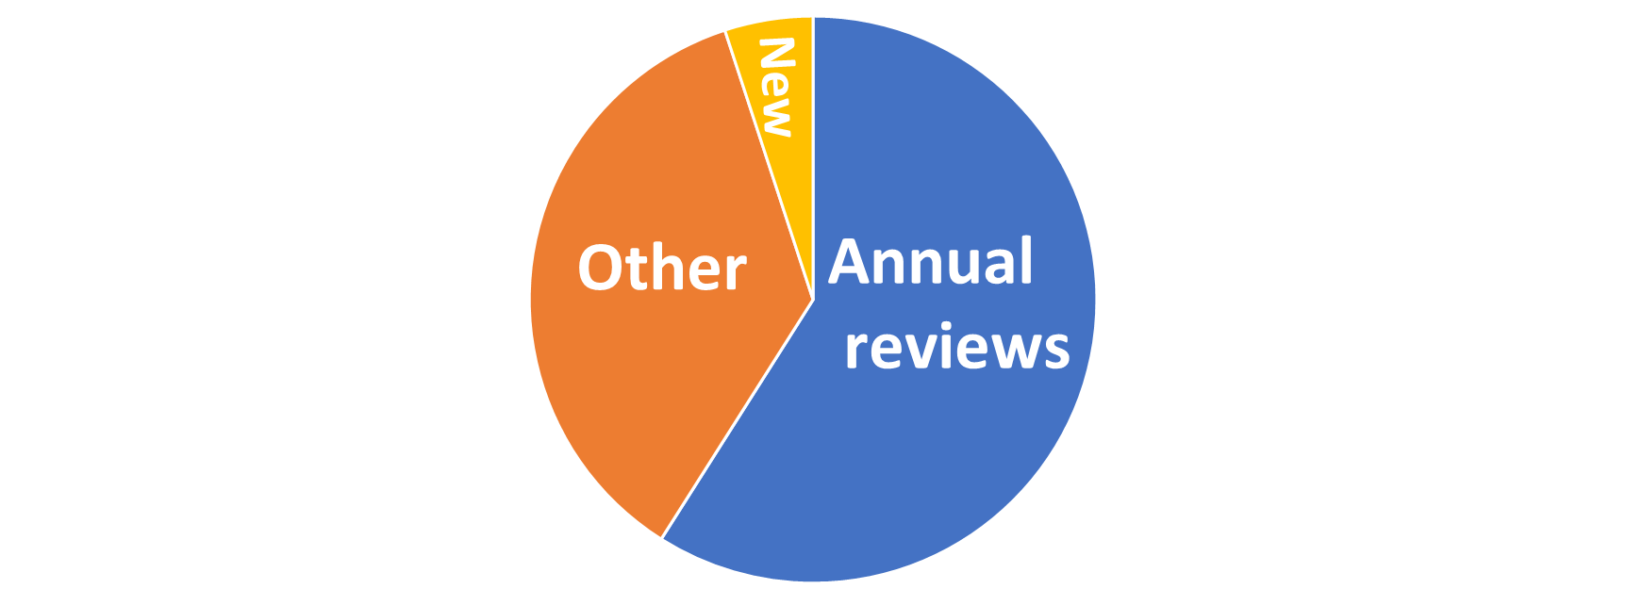
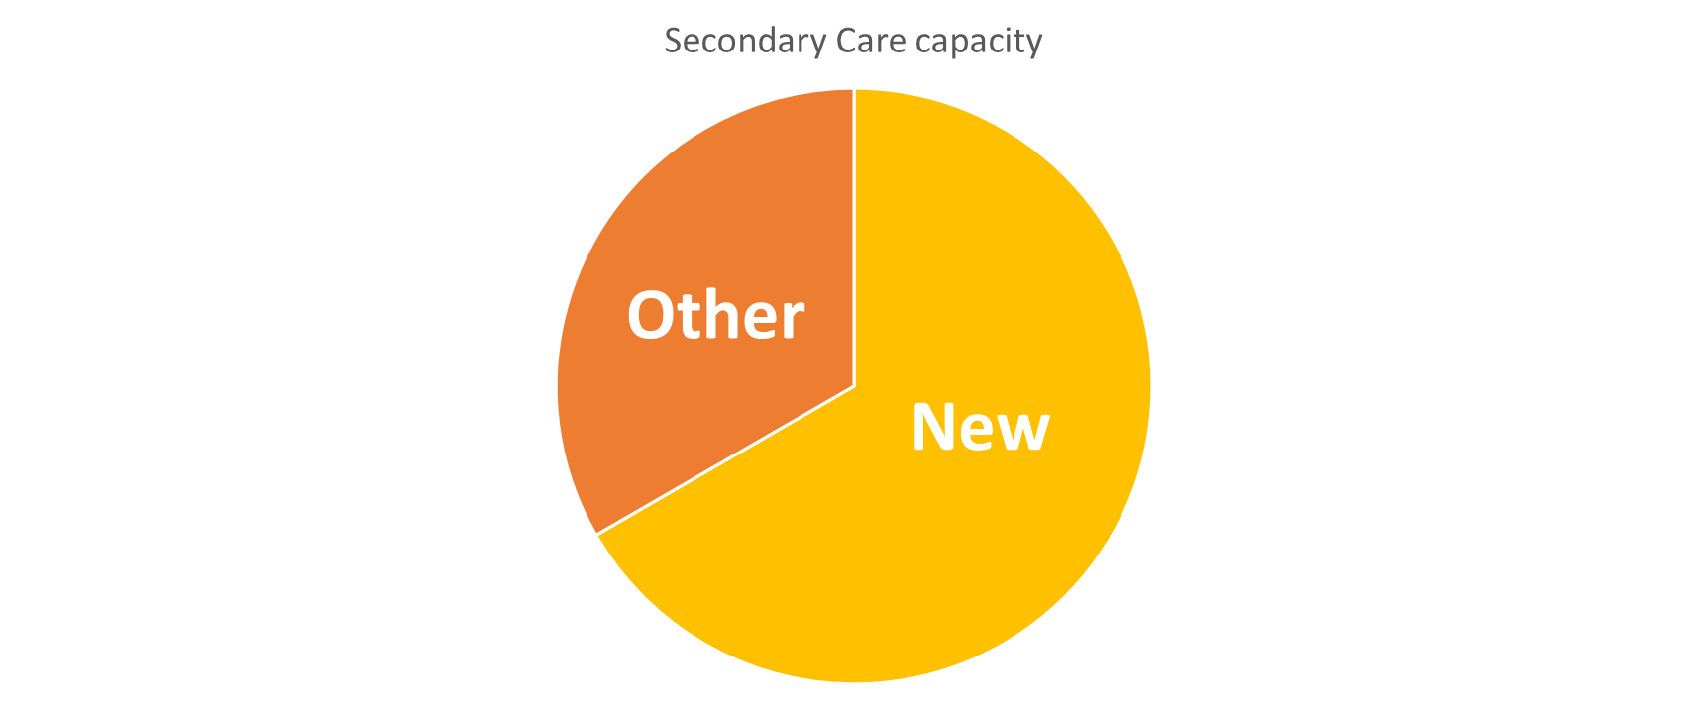








An innovative needs led adult ADHD service model
that will save money, create time back to care, meet policy objectives and improve lives of people in our society
Demand
Capacity
Primary Care
37k
£8.6m
89k
£103m
2024/25
2025/26
*C&M data
7% new assessments
Capacity created for 4.5k assessments
Policy
Social
Leaving people without support may result in:
Care closer to home
Analogue to digital
NHS
ADHD TASKFORCE
Urgent care demand
Economic inactivity
Offending behaviour
Sickness to prevention
Notes:
Demand – We have a high level of growing demand for ADHD services with very long waiting lists and no NHS commissioned capacity available. The total number of people in C&M diagnosed with ADHD is 37k. As we are unable to meet this demand, the current cost of non-contracted private provider activity is already £8.6million. The potential demand (4% of adult population) is 89k people. The projected cost to meet this demand is £103million in non-contracted private provider activity.
Capacity – The available capacity in our NHS specialist services is restricted by the requirements to undertake other activity relating to the existing caseload, predominantly the annual review. Only 7% of the current capacity is actually spent on new assessments. By reducing the number of referrals into secondary care and moving the annual review into primary care this model will create capacity for more new assessments, creating throughput from the waiting lists. Local data indicates moving the annual review alone could create capacity for over 4k new assessments.
Political – The model meets all three Darzi priorities by brining care closer to home (Enhancing Primary Care service offer), transitioning from analogue to digital (Introduction of digital technologies and connected infrastructure) and moving from sickness to prevention (a needs led support model to ensure the appropriate level of treatment in a timely manner, without the need for a diagnosis, preventing the escalation of symptoms and associated circumstances). It also spans elements of both of our core commissions and links with the work of the National Taskforce, where we are represented.
Social – ADHD has various co-morbidities and impacts on individual’s circumstances that can lead to an increase in urgent care demand (associated MH needs, greater risk of suicide, more accident prone etc), an increase in economic inactivity (high rates of unemployment) and an increase in offending behaviour (44% of people in prisons with undiagnosed ADHD) all of which have impacts on individuals and broader society.

Slide 3
Future state of adult ADHD services
A primary care based service enhancement that will result in improved access, patient flow
and workforce efficiencies
THE MAJOR CHANGES TO THE PATHWAY ARE:
CHANGE
CHANGE
1
CONSISTENT ONLINE EDUCATION REPOSITORY
4
DATA TRANSFER FROM PRIMARY CARE TO SECONDARY CARE
Provides validated educational self-care resources and digitally enhances the service by enabling electronic self-assessments.
CHANGE
Integrated digital infrastructure between primary and secondary care to enable data-sharing.
2
CHANGE
NEW NEURODIVERSITY PRACTITIONER ROLE
5
ANNUAL REVIEWS IN PRIMARY CARE
Introduction of a new role into primary care environment to provide more timely care closer to home without increasing GPs’ workload.
CHANGE
Enables annual reviews to take place in primary care, protecting capacity for new referrals in secondary care.
3
NEEDS LED APPROACH
Introduction of a needs led categorisation tool and associated support including a patient self-management platform to coordinate a variety of prescribed interventions.

Slide 4
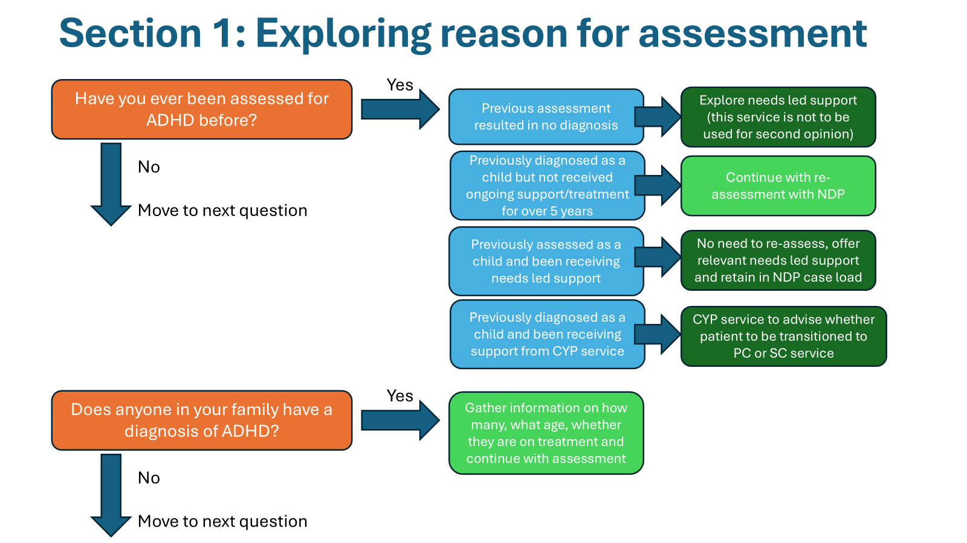
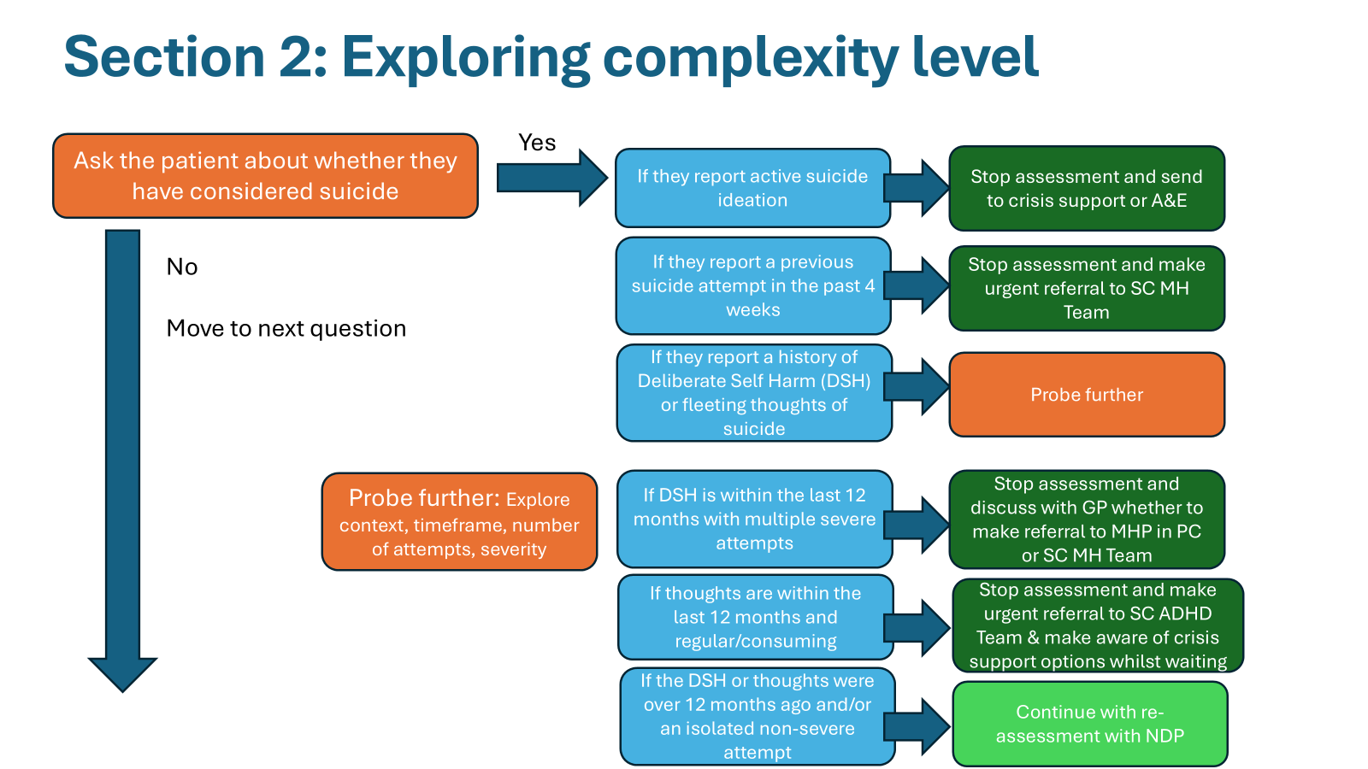
What is it?
Needs-led Categorisation Tool
The first section of the tool asks some quick and basic questions to identify why someone would like an assessment, aimed at identifying whether symptoms are consistent with ADHD, have been life long and across multiple domains of their life
The second section of the tool asks some key questions aimed at identifying the most complex individuals that would not be relevant for a Primary Care service to screen out quickly those that would need a referral to Secondary Care i.e. co-morbid SMI

Slide 5
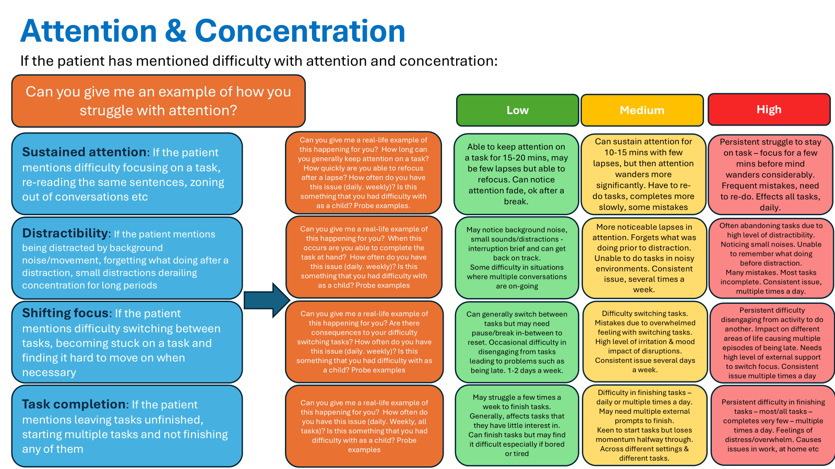
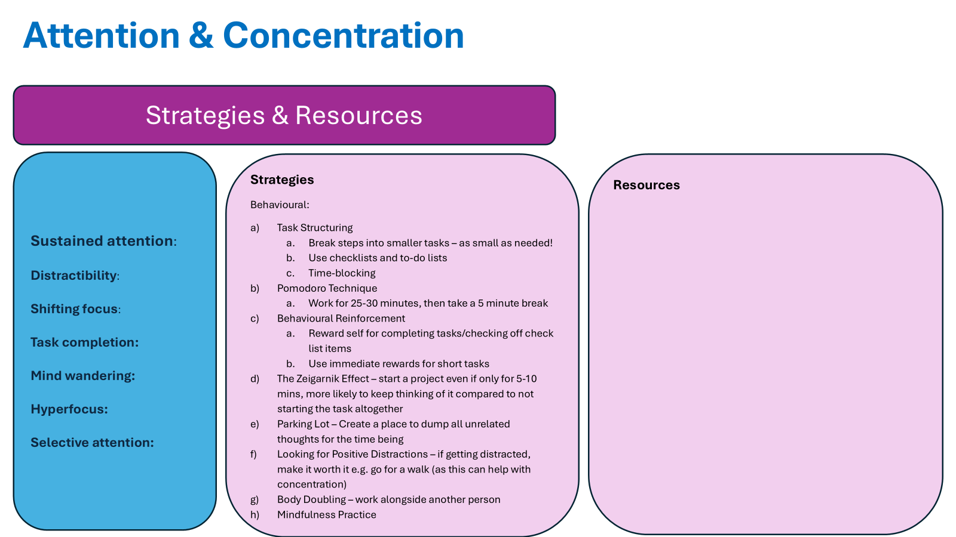
The third section of the tool has sections that relate to all the domains of the diagnostic criteria for ADHD, with probe questions to explore the complexity of symptoms associated with each area. It includes objective evidence-based information about what constitutes Low, Medium and High levels of need for each sub-domain to avoid subjective criteria found in other tools
This section also includes strategies and resources to support patients, in relation to each sub-domain. As well as information regarding differential diagnosis to support the practitioner when informing a patient that their symptoms do not correlate with ADHD, but perhaps relate to something else

Slide 6
Low need
Medium need
High need
Complex
If the patient scores mostly green, they are unlikely to have ADHD and can be offered some supportive strategies for their concerns but not retained on the NDP caseload
If the patient scores mostly amber, they are categorised as “need led support” and can be offered targeted interventions and retained on the NDP caseload
If the patient scores red in two or more domains, they are offered a diagnostic assessment in Primary Care by a specialist GP and can be offered ADHD medication and retained on the NDP caseload for annual reviews
If the patient is identified as being more complex in the first section of the categorisation they would be referred to SC for an assessment with a consultant

Slide 7
How has it been developed?
Needs-led Categorisation Tool
Chris Pritchard (Specialist GP), Rachael Kinnear (NDP) & Charlotte Hall (MH Lead, HINWC) have led on the development of the tool
A clinical working group including consultants and service leads from CWP & Mersey Care have inputted into the development and will continue to review and feedback
It has been approved by the ICB Clinical Effectiveness Group
It is currently in a testing phase
Nothing like this currently exists as it is distinct from risk stratification and formal diagnostic tools
All need-led thresholds used in the tool are fully evidenced in accordance with existing clinical guidance

